Slide 1
Molecular Dynamics
Time Correlation Functions
Yuan Ping
Credits to Dane Morgan’s lectures

Slide 2
Outline
Time correlation functions
What thermodynamic averages mean in time correlation functions

Slide 3
Time Correlation Functions
The time correlation function is the thermodynamic average (over the statistical ensemble of states) of a product of two quantities at different times
Their time integrals are often related to transport coefficients, their Fourier transformed time integrals related to spectra
For transport coefficients, there is an associated Einstein relation that also give the coefficient
Example: the diffusion constant D for atom i.
From time correlation function
From Einstein relation

Slide 4
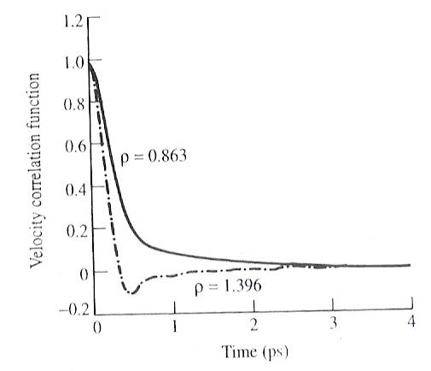
Time Correlation Function: Velocity-Velocity and Diffusion Constant
Lennard-Jones fluid
D_{0.863} / D_{1.396}≈ 2 assuming <v²> are equal
Leach fig 7.10 p.377
What does the negative value mean?

Slide 5
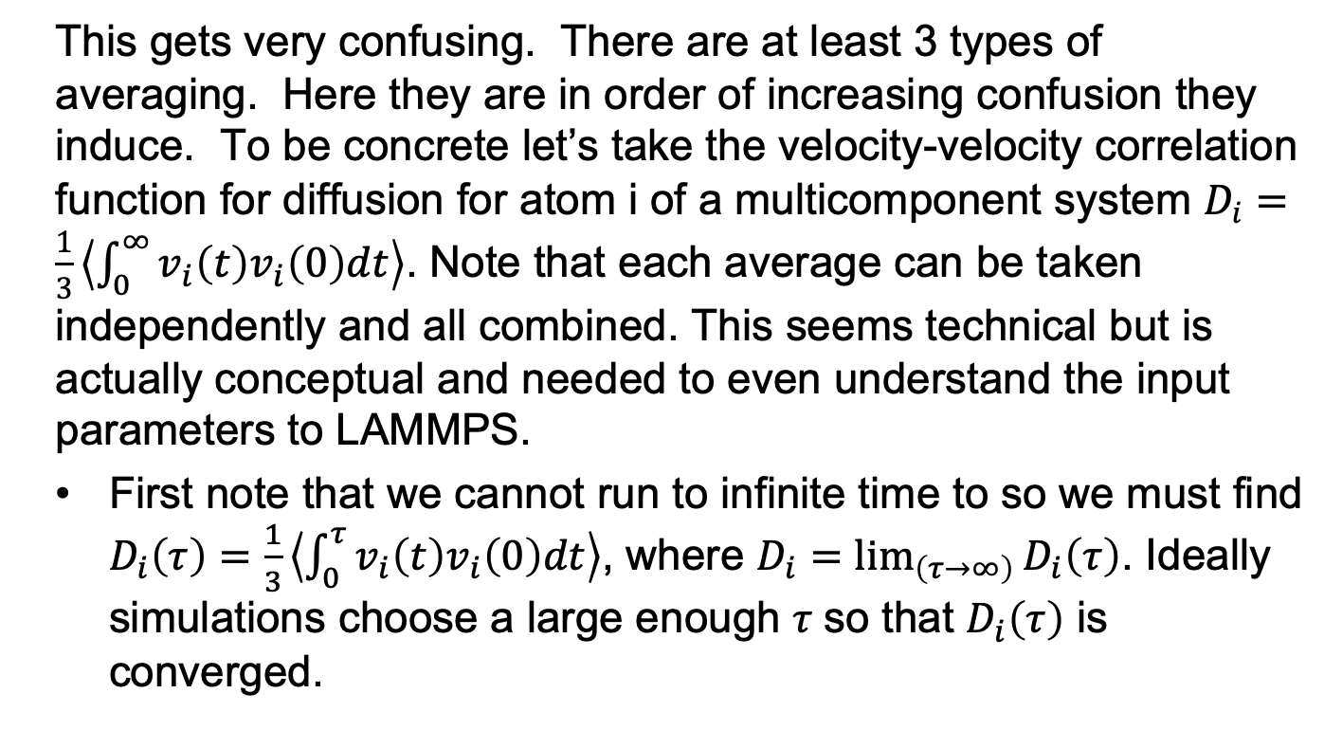
What Averaging is Done in Time Correlation Functions?
This gets very confusing. There are at least 3 types of averaging. Here they are in order of increasing confusion they induce. To be concrete let’s take the velocity-velocity correlation function for diffusion for atom i of a multicomponent system $D_{i}=\frac{1}{3}\left\langle \int_{0}^{∞}{v_{i}\left(t\right)v_{i}\left(0\right)dt}\right\rangle$. Note that each average can be taken independently and all combined. This seems technical but is actually conceptual and needed to even understand the input parameters to LAMMPS.
First note that we cannot run to infinite time to so we must find $D_{i}\left(τ\right)=\frac{1}{3}\left\langle \int_{0}^{τ}{v_{i}\left(t\right)v_{i}\left(0\right)dt}\right\rangle$, where $D_{i}=\lim_{\left(τ→∞\right)}{D_{i}\left(τ\right)}$. Ideally simulations choose a large enough $τ$so that $D_{i}\left(τ\right)$ is converged.

Slide 6
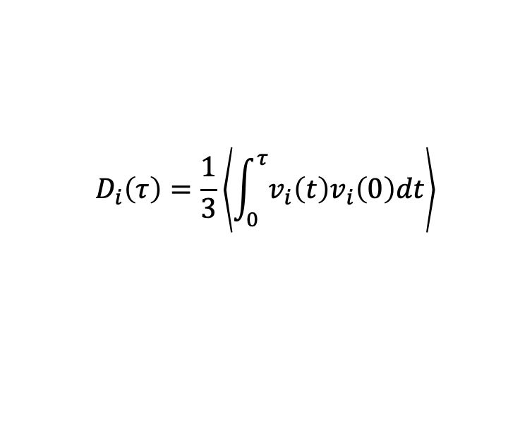
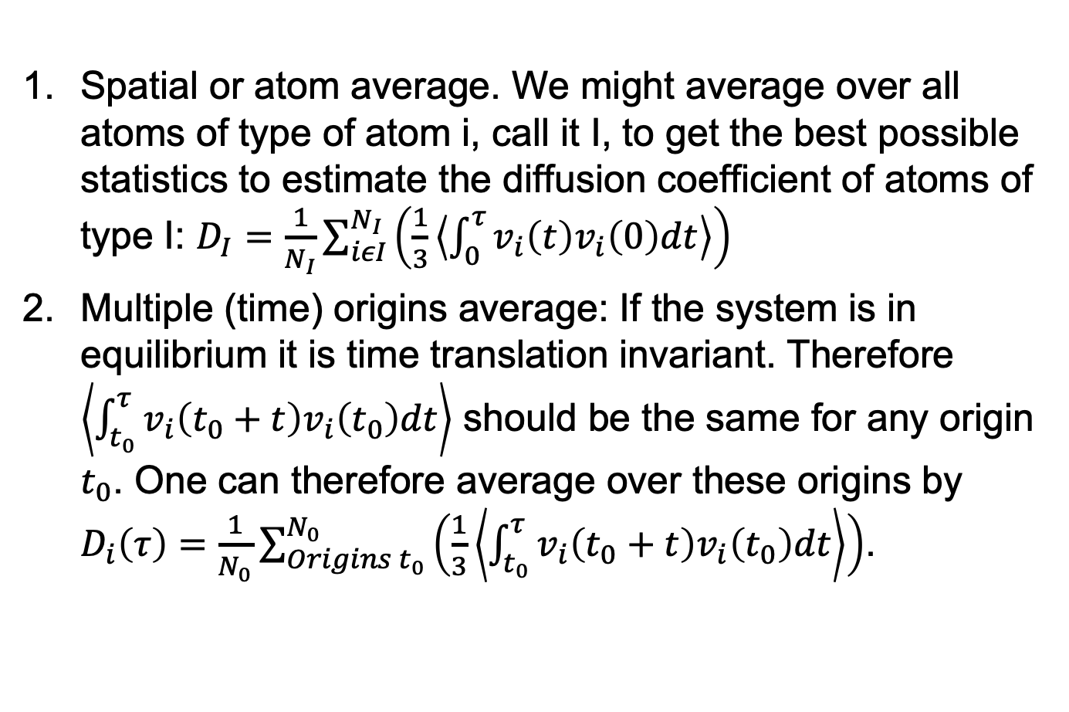
What Averaging is Done in Time Correlation Functions?
$$D_{i}\left(τ\right)=\frac{1}{3}\left\langle \int_{0}^{τ}{v_{i}\left(t\right)v_{i}\left(0\right)dt}\right\rangle$$
Spatial or atom average. We might average over all atoms of type of atom i, call it I, to get the best possible statistics to estimate the diffusion coefficient of atoms of type I: $D_{I}=\frac{1}{N_{I}}\sum_{iεI}^{N_{I}}{\left(\frac{1}{3}\left\langle \int_{0}^{τ}{v_{i}\left(t\right)v_{i}\left(0\right)dt}\right\rangle \right)}$
Multiple (time) origins average: If the system is in equilibrium it is time translation invariant. Therefore $\left\langle \int_{t_{0}}^{τ}{v_{i}\left(t_{0}+t\right)v_{i}\left(t_{0}\right)dt}\right\rangle$ should be the same for any origin $t_{0}$. One can therefore average over these origins by $D_{i}\left(τ\right)=\frac{1}{N_{0}}\sum_{Origins t_{0}}^{N_{0}}{\left(\frac{1}{3}\left\langle \int_{t_{0}}^{τ}{v_{i}\left(t_{0}+t\right)v_{i}\left(t_{0}\right)dt}\right\rangle \right)}$.

Slide 7
What Averaging is Done in Time Correlation Functions?
$$D_{i}\left(τ\right)=\frac{1}{3}\left\langle \int_{0}^{τ}{v_{i}\left(t\right)v_{i}\left(0\right)dt}\right\rangle$$
3. Ensemble average: The ensemble average is over microstates. Technically this is the microstates of the starting time ensemble (ie, all states at time 0).
s₁
s₂
s₃
t
t₁
So how do I do this?

Slide 8
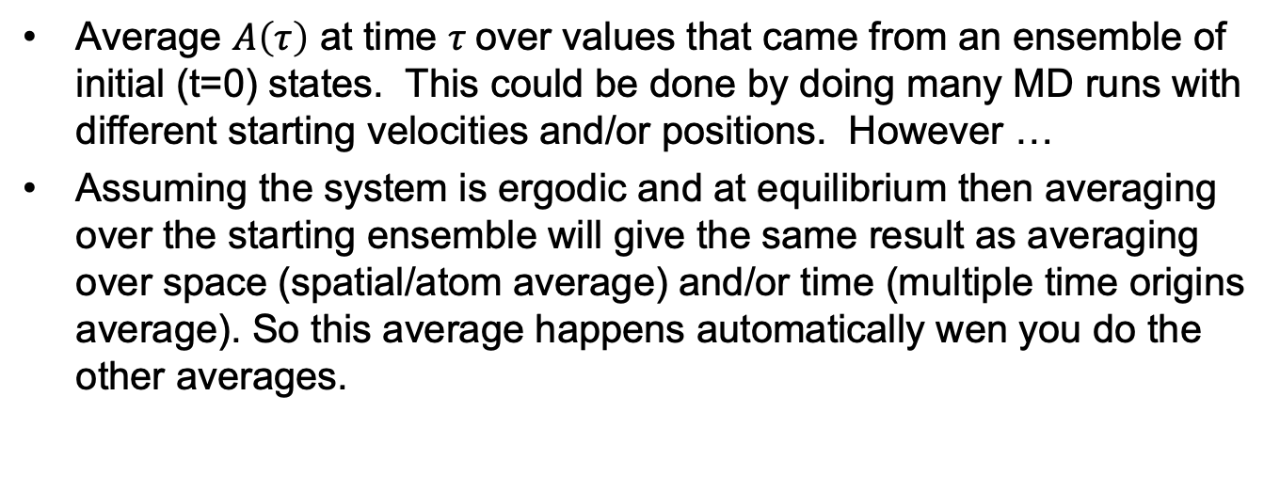
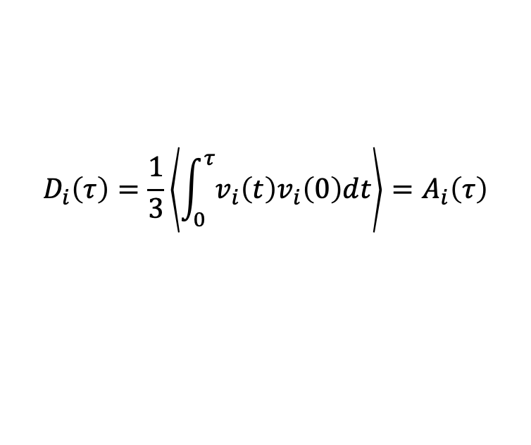
What Averaging is Done in Time Correlation Functions?
$$D_{i}\left(τ\right)=\frac{1}{3}\left\langle \int_{0}^{τ}{v_{i}\left(t\right)v_{i}\left(0\right)dt}\right\rangle =A_{i}\left(τ\right)$$
Average $A\left(τ\right)$ at time $τ$over values that came from an ensemble of initial (t=0) states. This could be done by doing many MD runs with different starting velocities and/or positions. However …
Assuming the system is ergodic and at equilibrium then averaging over the starting ensemble will give the same result as averaging over space (spatial/atom average) and/or time (multiple time origins average). So this average happens automatically wen you do the other averages.

Slide 9
Summary
Time correlation functions give kinetic coefficients of linear response theory (from the fluctuation-dissipation theorem).
The diffusion coefficient is given by the velocity-velocity time correlation function and the Einstein relation.
Time correlations functions typically need to
  Approximate infinte time with a finite limit.
  Average over space/atoms and time origins.
  Average over ensembles, but this comes for free from space and time averaging.

